Slide 1

Alpha Anywhere Q&A
February 2, 2022

Slide 2

Publishing Mobile Apps with Ionic Appflow

Slide 3

AGENDA
Overview & Required Resources
Cordova Builder
Publishing to Ionic Appflow
Building and Testing
Common Mistakes

Slide 4
Overview
Ionic Appflow is a cloud-based service that allows an Alpha mobile app developer to build Cordova apps for iOS or Android in the cloud.

Slide 5
Required Resources
Paid Ionic Appflow Account
GitHub Account
GitHub Desktop
Apple Developer Account - iOS
Google Play Developer Account - Android
Application Server
Database/Storage hosting (Alpha Cloud)

Slide 6

Alpha Anywhere Cordova Builder

Slide 7
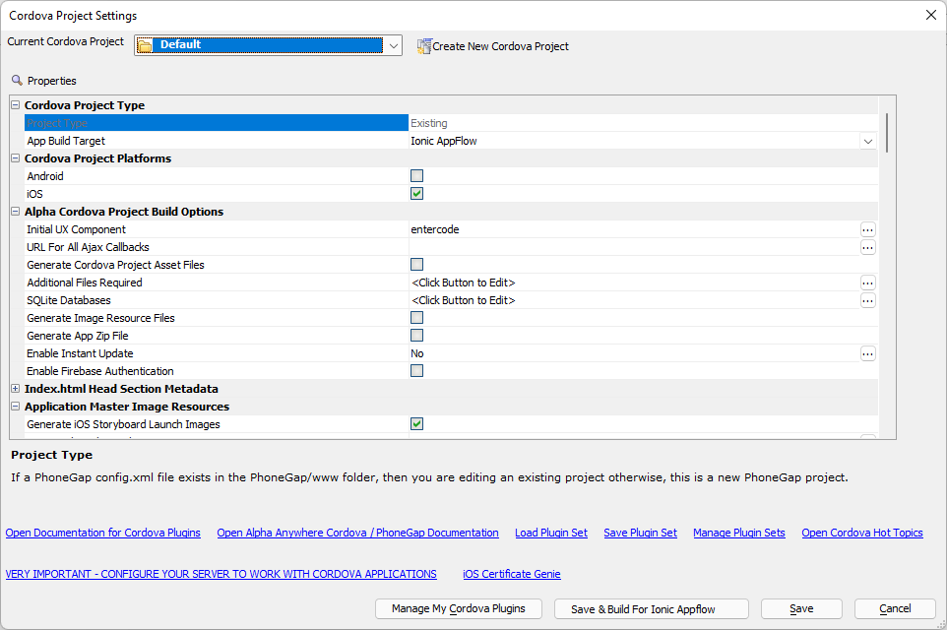
Cordova Builder
Generates the assets required to build your app with Ionic Appflow.

Slide 8
App Publish Workflow in Alpha Anywhere

Slide 9
Publishing Your App Files
Publish your app to the Application Server
Configure the app info and assets, including icons, storyboard and 9-patch images, developer info, and required plugins
Generate the Ionic Appflow files
Commit generated files to GitHub

Slide 10
Ionic Appflow Project

Slide 11
Ionic Appflow Project
Create a new project
Link it to the GitHub repository

Slide 12
App Building Workflow in Ionic Appflow

Slide 13
Building and Testing
Start a build on Ionic Appflow:
Choose the Commit to use
Choose target platform and type (debug, development)
Add Certificates (you only have to do this once)
Build the App

Slide 14
Certificates
Do you need one?

Slide 15
iOS Certificate Genie
requires an Apple Developer Account
does NOT require a Mac
walks through creating the certificate from within Alpha Anywhere
Recommended iOS Certificate type:
Apple Development
Apple Distribution

Slide 16
A quick note on iOS Provisioning Profiles

Slide 17
iOS Provisioning Profiles
The Provisioning Profile needs to include the UDID of any devices you plan to use for testing.
If you add a UDID to the Provisioning Profile after building your app in Ionic, you must rebuild your app with the new Provisioning Profile.

Slide 18
Testing!

Slide 19
Testing
iOS
TestFlight
Daiwi
Android
Testing tracks

Slide 20
Common Mistakes
Mostly just mistakes we've seen when building for iOS

Slide 21
Common Mistakes and How to Avoid them
Error: Source path does not exist: resources/screen/ios/Default@2x~universal~anyany.png
Cause: iOS Storyboard images were not defined

Slide 22
Common Mistakes and How to Avoid them
Error: security: SecKeychainItemImport: MAC verification failed during PKCS12 import (wrong password?)
Cause: something is wrong with iOS Certificate (password, type, etc)

Slide 23
Common Mistakes and How to Avoid them
Error: Unable to Install, This app cannot be installed because its integrity could not be verified (Seen when installing an app using Diawi)
Cause: UDID missing from Provisioning Profile

